Slide 1
Java EE : Programming Servlets

Slide 2

Creating Servlets in Packages
Package Servlets Deployment

Slide 3
Creating Servlets in Packages

Slide 4
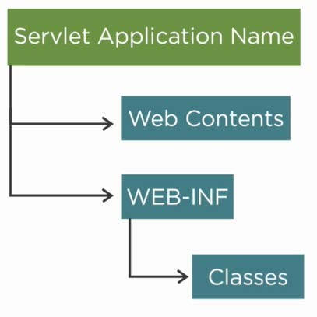
Basic Folder Structure
for Servlet for Application

Slide 5
Package Servlets Deployment

Slide 6
Cold Deployment
Hot Deployment
Require one or more instances of the server to restart to reflect the changes
Advantage No caching
No out of memory issues
Deploy and undeploy web applications with out restarting the server
Advantage Prevents from manual restart of production server
Cons
Cons
Simultaneous deployment in all nodes, resulting in down time Out of memory issues
Outage cost is more

Slide 7
Package Servlets Deployment
Copy the web archive webapps/of Tomcat
Using the Tomcat "Manager" web application

Slide 8

Creating Servlets in Packages
Package Servlets Deployment

